Slide 1
Automated detection of relativistic electron enhancement events in Earth’s magnetotail
Kiley Yeakel, Drew Turner & Ian Cohen
Space Exploration Sector
Johns Hopkins University Applied Physics Lab
Kiley.Yeakel@jhuapl.edu
Machine Learning in Heliophysics
March 22, 2022

Slide 2
Outline
Study Motivation:
What are electron injection events?
Where are they occurring? What is driving them?
Data Set & Pre-processing
Relevant MMS data sets
Algorithm Description
Algorithm performance in comparison with the labeled subset
Preference for false positives over false negatives
Modeling the Magnetopause
Statistical study of the variance in SW driving conditions and resulting variance in the MP location
Statistical Study of Peak Occurrence
Comparison with previous studies
Correlations with local and driving solar wind conditions
Future Direction

Slide 3
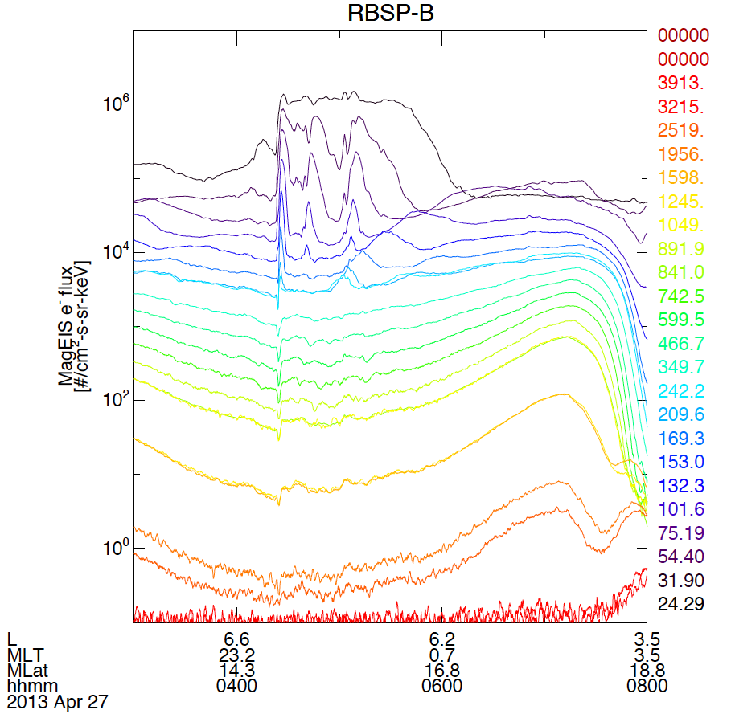
What are Relativistic Electron Injections?
Sudden, localized enhancements of 10s to 100s of keV (and sometimes higher) particles from the Earth’s magnetotail into the inner magnetosphere (L < 10)
Electron injections events are known to occur frequently
Several per day in the inner magnetosphere
As move radially inwards, occurrence rate increases dusk ward → electron drift physics
Occurrence rate increases with increasing geomagnetic activity
Bursts of relativistic electrons (> 500 keV) observed far down-tail associated with substorm activity by IMP-8 and ISEE-3 (Baker and Stone, 1997; Slavin et al., 1992; Richardson et al., 1993)
Occurrence rate also appears associated with depolarizing flux bundles
Dispersionless
Dispersed (drift echo)

Slide 4
Study Objective: Where & when are these events occurring? What is driving them?
The magnetosphere is an effective and efficient accelerator of relativistic electrons
X. Li et al., (GRL 1997) – Solar wind is an insufficient source of outer belt electrons; some additional acceleration must be occurring within the magnetosphere
Considered important to source processes of ring current ions and radiation belt electrons
What mechanism(s) is (are) accelerating these electrons so effectively?
Are there spatial and temporal patterns in the magnetosphere where these events are happening?
Are there clusters of events which appear similarly in feature space?
Study Approach
(Completed) Collect a list of electron enhancement events across sufficient spatial and temporal scales
Improve the catalog of known events in the literature
Explore spatial and temporal relationships between event occurrence and particular solar wind, magnetospheric, and/or local plasma conditions
(Ongoing) Use unsupervised ML techniques to explore subpopulations within the events
Can unsupervised clustering differentiate between different known drivers of electron enhancement in the magnetotail (e.g. dipolarization injections vs. plasma sheet flapping)
Are there populations of events that look similar in feature-space, driven by similar physics?

Slide 5
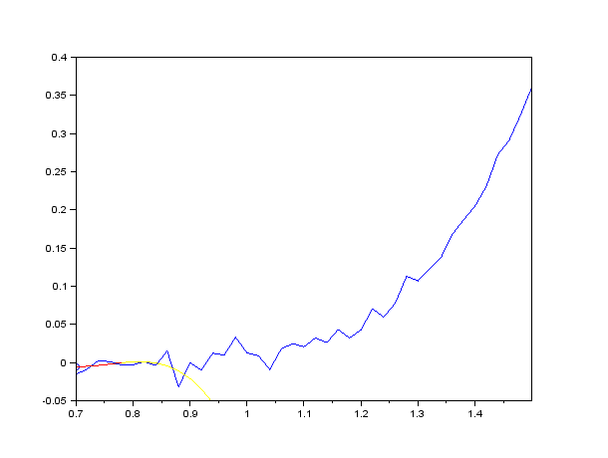
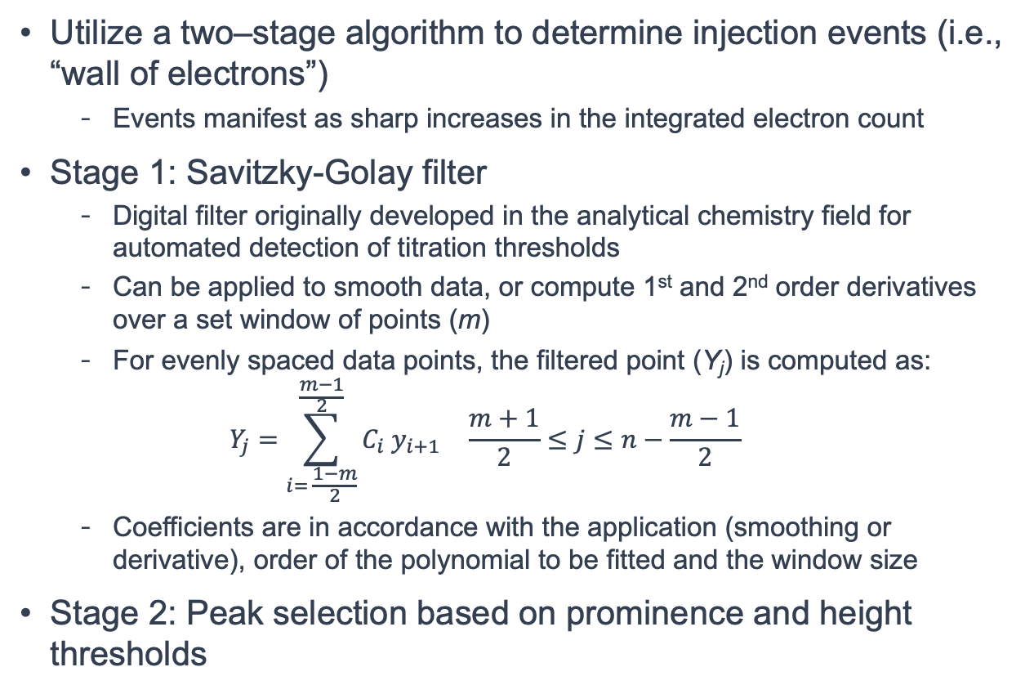
Event Identification Algorithm Description
Utilize a two–stage algorithm to determine injection events (i.e., “wall of electrons”)
Events manifest as sharp increases in the integrated electron count
Stage 1: Savitzky-Golay filter
Digital filter originally developed in the analytical chemistry field for automated detection of titration thresholds
Can be applied to smooth data, or compute 1st and 2nd order derivatives over a set window of points (m)
For evenly spaced data points, the filtered point (Y_{j}) is computed as:
$$Y_{j}=\sum_{i= \frac{1−m}{2}}^{\frac{m−1}{2}}{C_{i}{ y}_{i+1}} \frac{m+1}{2}≤j≤n−\frac{m−1}{2}$$
Coefficients are in accordance with the application (smoothing or derivative), order of the polynomial to be fitted and the window size
Stage 2: Peak selection based on prominence and height thresholds
Animation of SG filter applied on sequential data points to smooth the original signal.
By Cdang - Own work, CC BY-SA 3.0, https://commons.wikimedia.org/w/index.php?curid=24312864

Slide 6
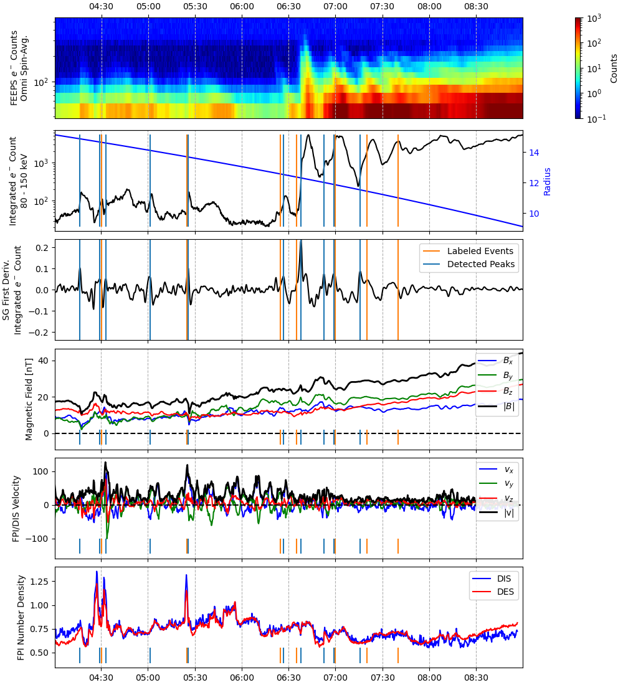
Data Set
Utilizing MMS tail season data from 2017 – 2021
Manually-identified injection events for a subset of the 2018 tail season
Utilizing only a single spacecraft, though algorithm is extensible to the others
Event detection algorithm designed to identify events based only on the integrated electron count
Contemporaneous FPI ion/e⁻ velocity, temperature and density, MAG field included for subsequent clustering study
Generally find the algorithm identifies far more events than present in the labeled set
Capturing dispersed and dispersionless events
Peak identification (stage 2) needed the most rigorous tuning to focus only on substantial events
Attributed to under-labeling of events or mis-labeling
Timing off significantly in manual list
Manual list focused on larger events whereas algorithm will identify sub-peaks in larger event
Final manually-labeled event at figure to right is an example of biased identification

Slide 7
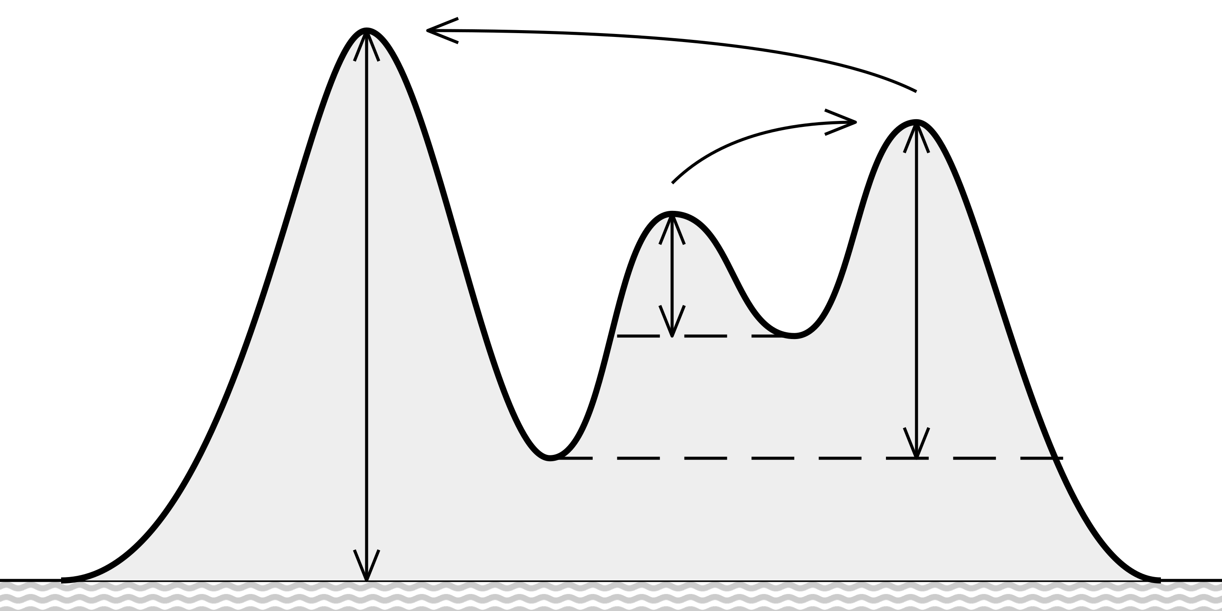
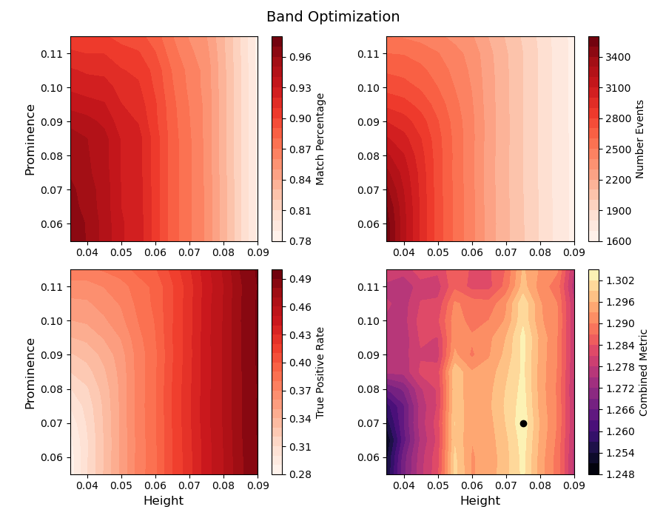
Algorithm Tuning
Height
Threshold
Completed a grid search for the optimal set of parameters:
Step 1: Savitzky-Golay filter
Filter width
Degree of polynomial
Features to include → integrated total electron count over specified energy range
Step 2: Peak detection on e⁻ integrated count derivative
As Prominence increases → Will favor large positive swings in the derivative, but the absolute value of the derivative at the peak height does not matter
As Height increases → Sets a minimum threshold on the value of derivative at the peak, so absolute value of the derivative does matter
Weighing two competing metrics
TPR = True Positive Rate = True Positive / Positive Samples = % of labeled events detected
Precision = % of detections that are real = TP / (TP + FP)
Prominence threshold
By Cmglee, https://en.wikipedia.org/wiki/Topographic_prominence#/media/File:Prominence_definition.svg

Slide 8
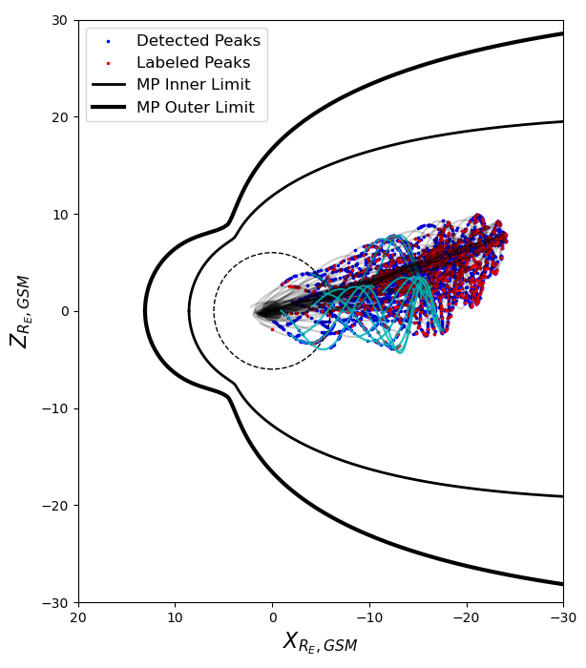
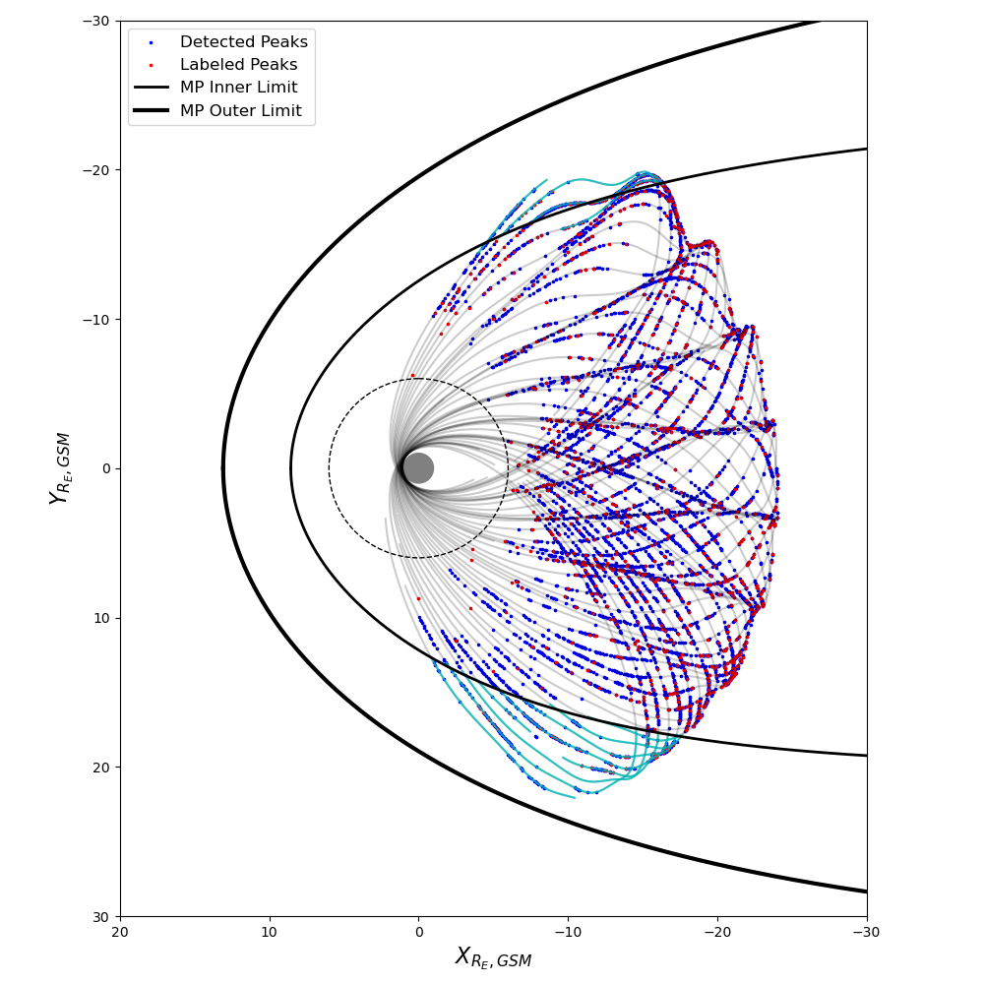
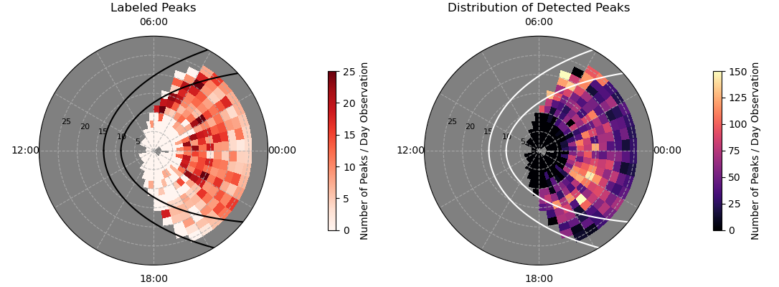
Event Statistics for 2018 Partial Tail Season
6 R_{E} exclusion zone
1041 events labeled by Turner from 5/27/2018 through 9/25/2018
95.68% of the labeled events (996 total) were identified by the algorithm; 45 labeled events missed
Missed events were mostly driven by labeling inaccuracies
Algorithm identified an additional ~4800 events over the labeled time span
Every peak identified in larger multi-peak event whereas labeled data set focused on the larger events

Slide 9
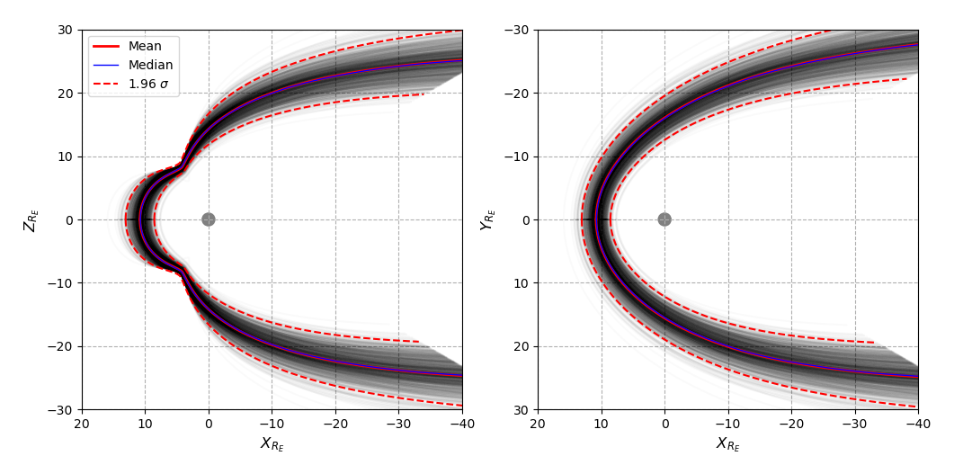
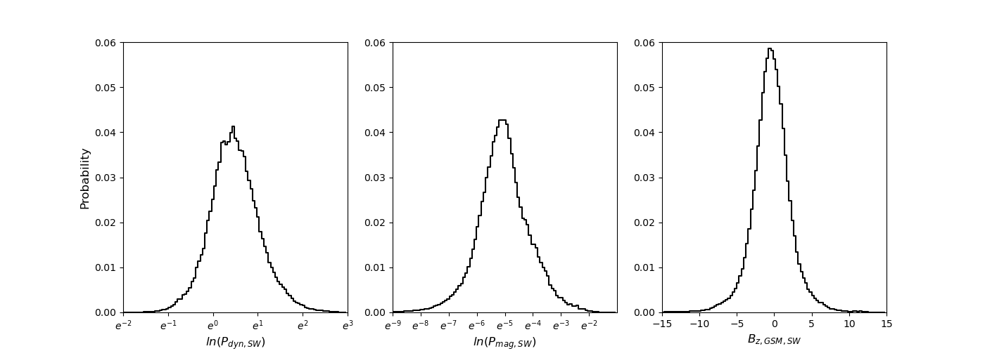
Modeling Statistical Variance in the Magnetopause Location
Model the multivariate distribution
Draw random samples
Compute the variance in the MP location
Assume Multivariate Gaussian fit
Univariate distributions found to be:
B_{z}: Normal
P_{dyn}: Log-normal
P_{mag}: Log-normal
Draw 1000 random samples from the multivariate distribution
For each random draw, compute the MP location from the Lin et al., 2010 model
Compute the median, avg, and 1.96 sigma fits (95% confidence)
Monte Carlo
Lin, R. L., et al. "A three‐dimensional asymmetric magnetopause model." Journal of Geophysical Research: Space Physics 115.A4 (2010).

Slide 10
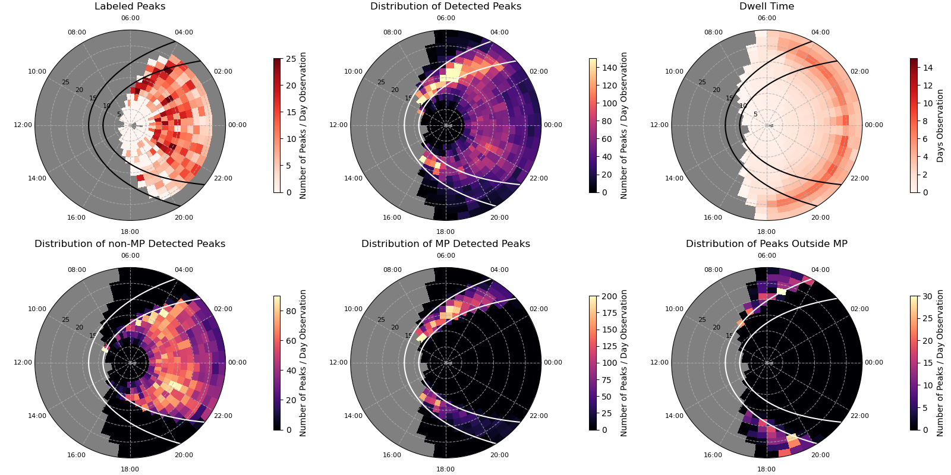
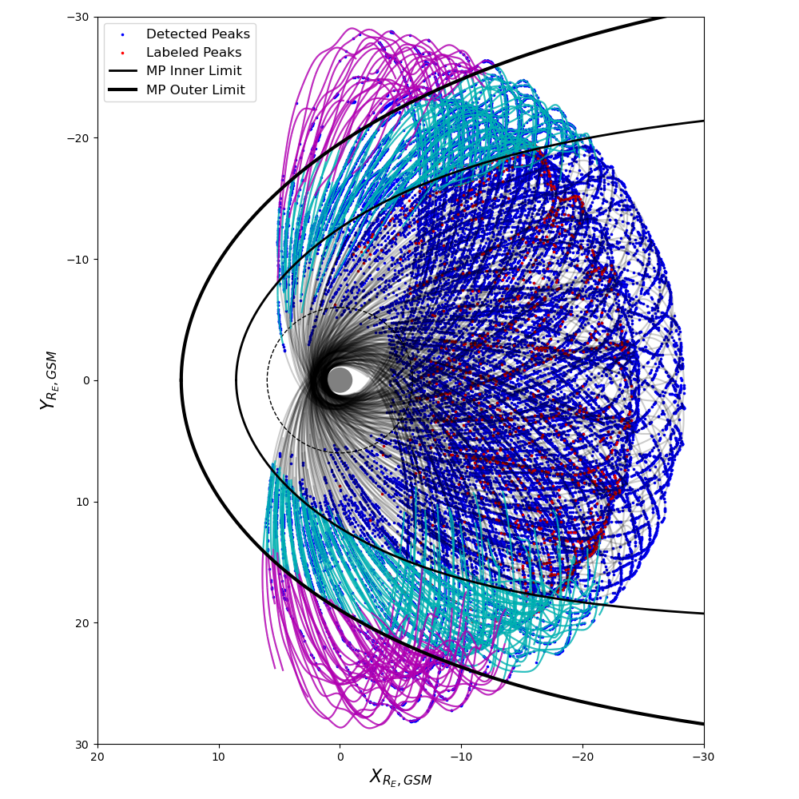
Extension to all Tail Seasons (2017 – 2021)
Note: projection of 3D orbit trajectory with equatorial MP boundary
~37k peaks found across 5 summer tail seasons
Clear pattern of peaks near the dawn-side magnetopause (dawn-dusk asymmetry evident)
Peaks coincident with possible BBFs evident near midnight

Slide 11
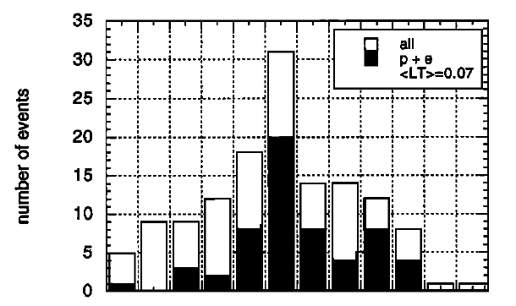
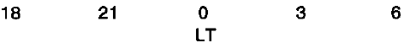
Comparison to Previous Results
20
10
Birn et al., 1997
Gabrielse et al., 2014
Yeakel et al., in prep., 2022
Agreement with previous studies on premidnight increased occurrence of dispersionless electron injection events
Substantially greater event catalog (37k peaks) compared to prior studies:
Birn et al., (1997): 134 dispersionless injections, GEO-orbit only
Gabrielse et al., (2014): 1624 dispersionless electron injections, THEMIS

Slide 12
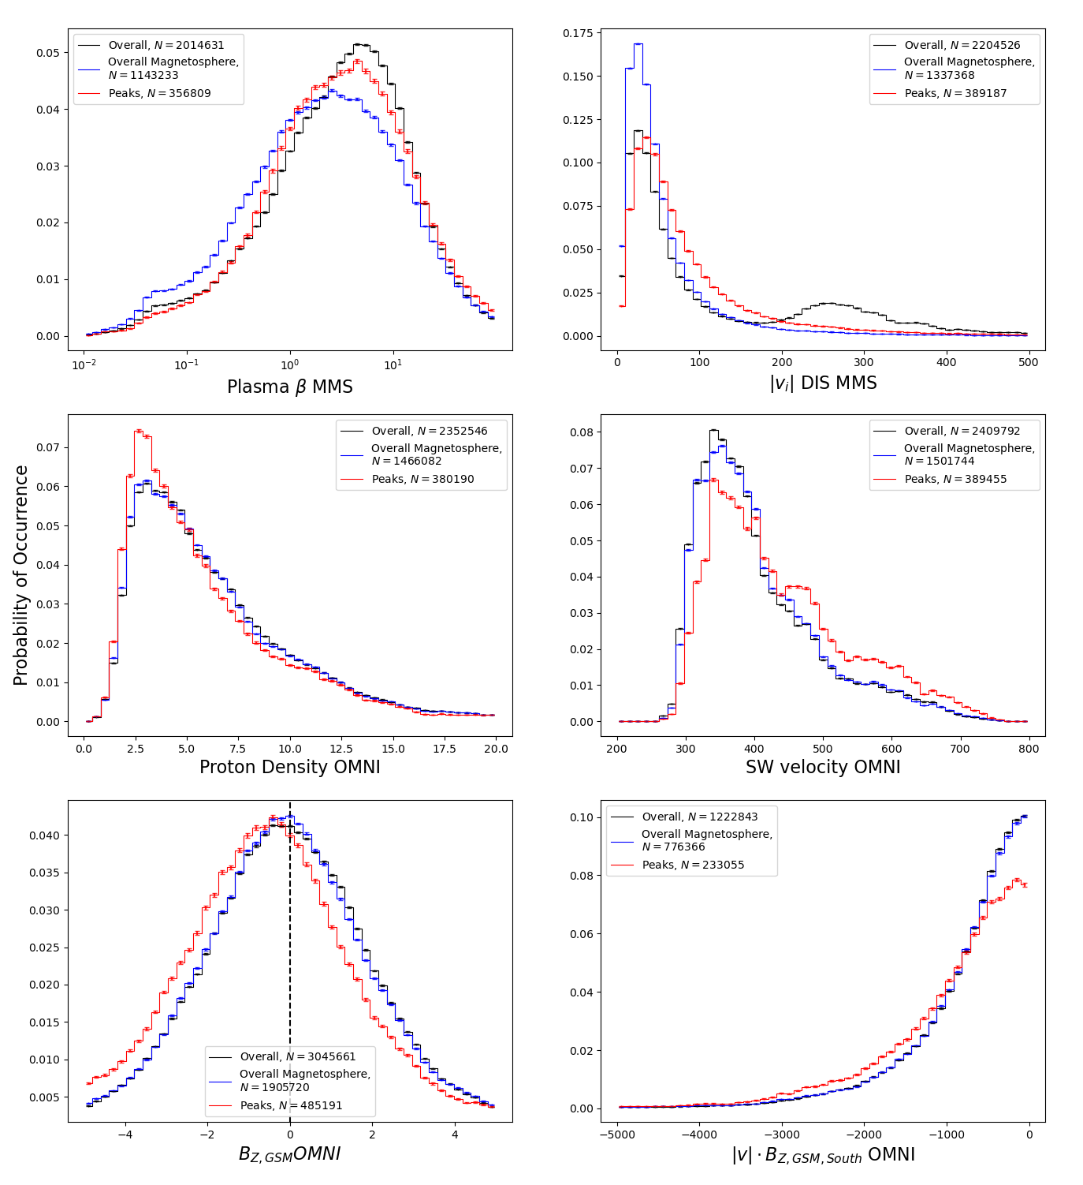
Local Plasma and SW Conditions
Solar wind and magnetosheath
Local plasma conditions at the time of peak occurrence (within 5 minutes) show significant deviation from bulk magnetosphere/magnetotail conditions
Plasma beta is increased in-situ relative to the bulk magnetosphere population
DIS-measured ion velocity is increased
SW conditions likewise show a significant deviation
SW proton density is decreased
SW velocity is increased
SW B_{z} is skewed negative
|v| B_{z, South} is higher magnitude
All of this is generally consistent with expected conditions for substorm activity and energetic particle injections
Local conditions indicate BBFs in the central plasma sheet → increased ion velocity and plasma beta
Solar wind conditions consistent with enhanced dayside reconnection and global convection

Slide 13
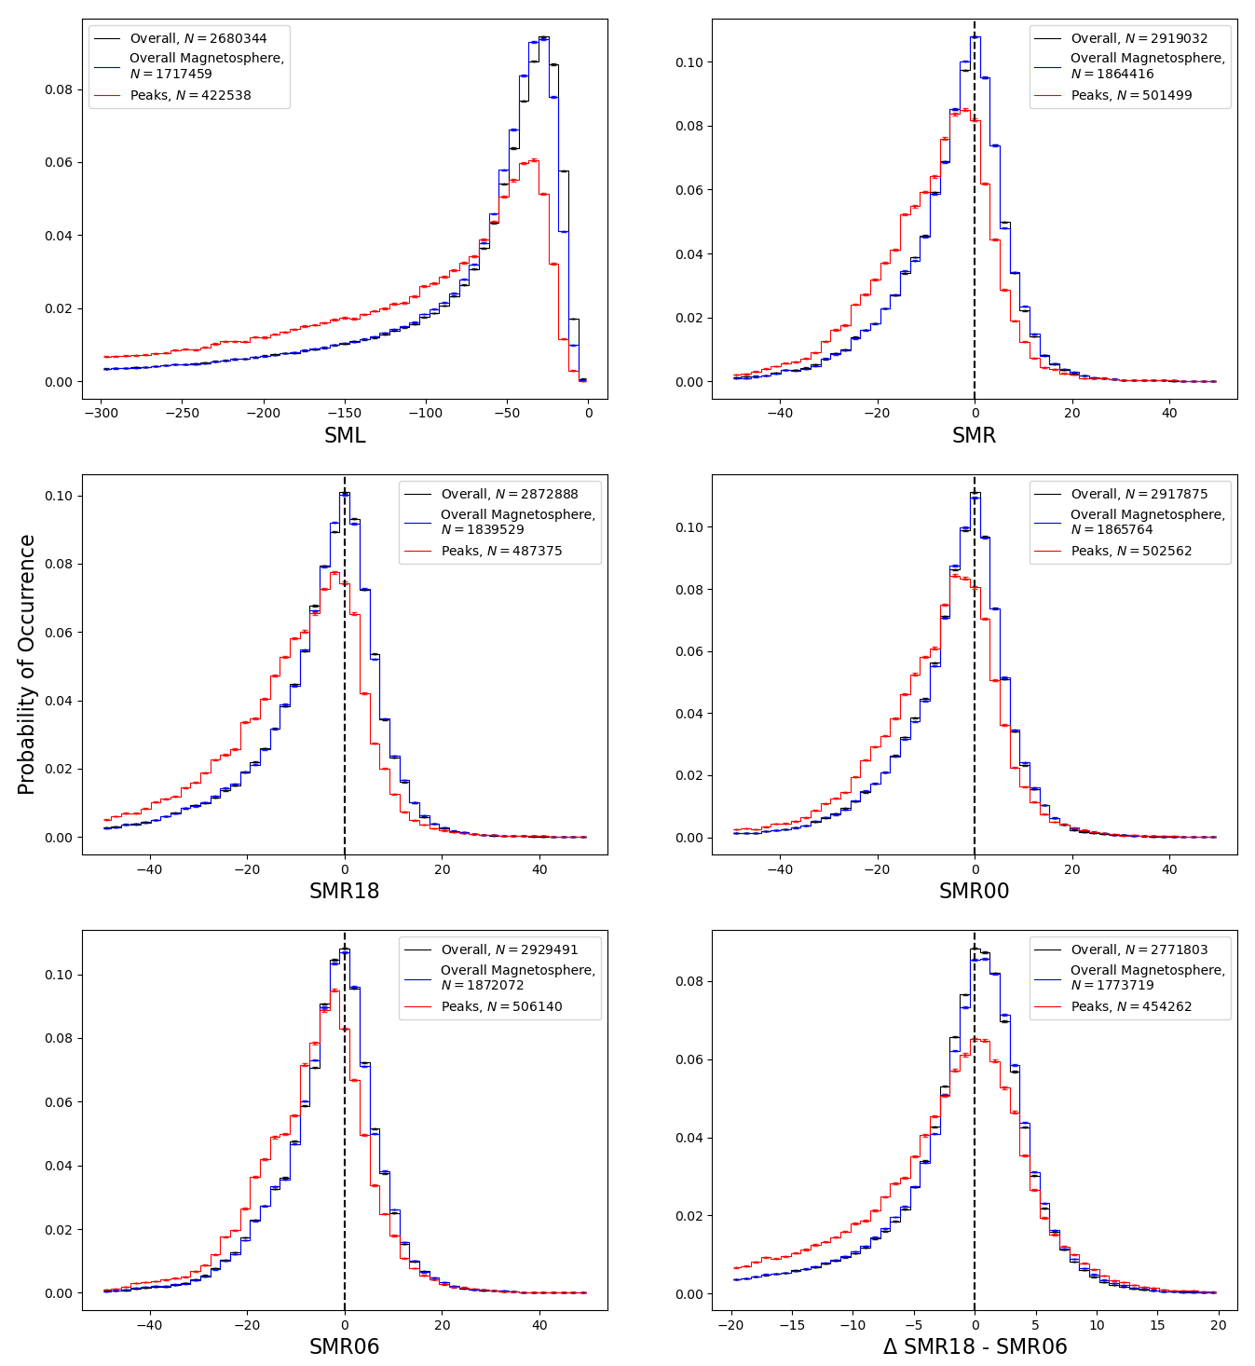
Index Conditions
Global and regional index data demonstrates significant shift correlated with peak occurrence
Global SML and SMR are significantly skewed negative
Regional SMR values also show universal negative skew
Difference between dusk (SMR18) and dawn (SMR06) indices shows strength of decrease is exacerbated on the dusk flank
All of this is generally consistent with expected conditions for substorm activity and energetic particle injections
SML (AL) indicates substorm and enhanced auroral activity
SMR (Sym-H) skewed negative indicates enhanced global convection
SMR localtime asymmetry indicates partial ring current activity

Slide 14
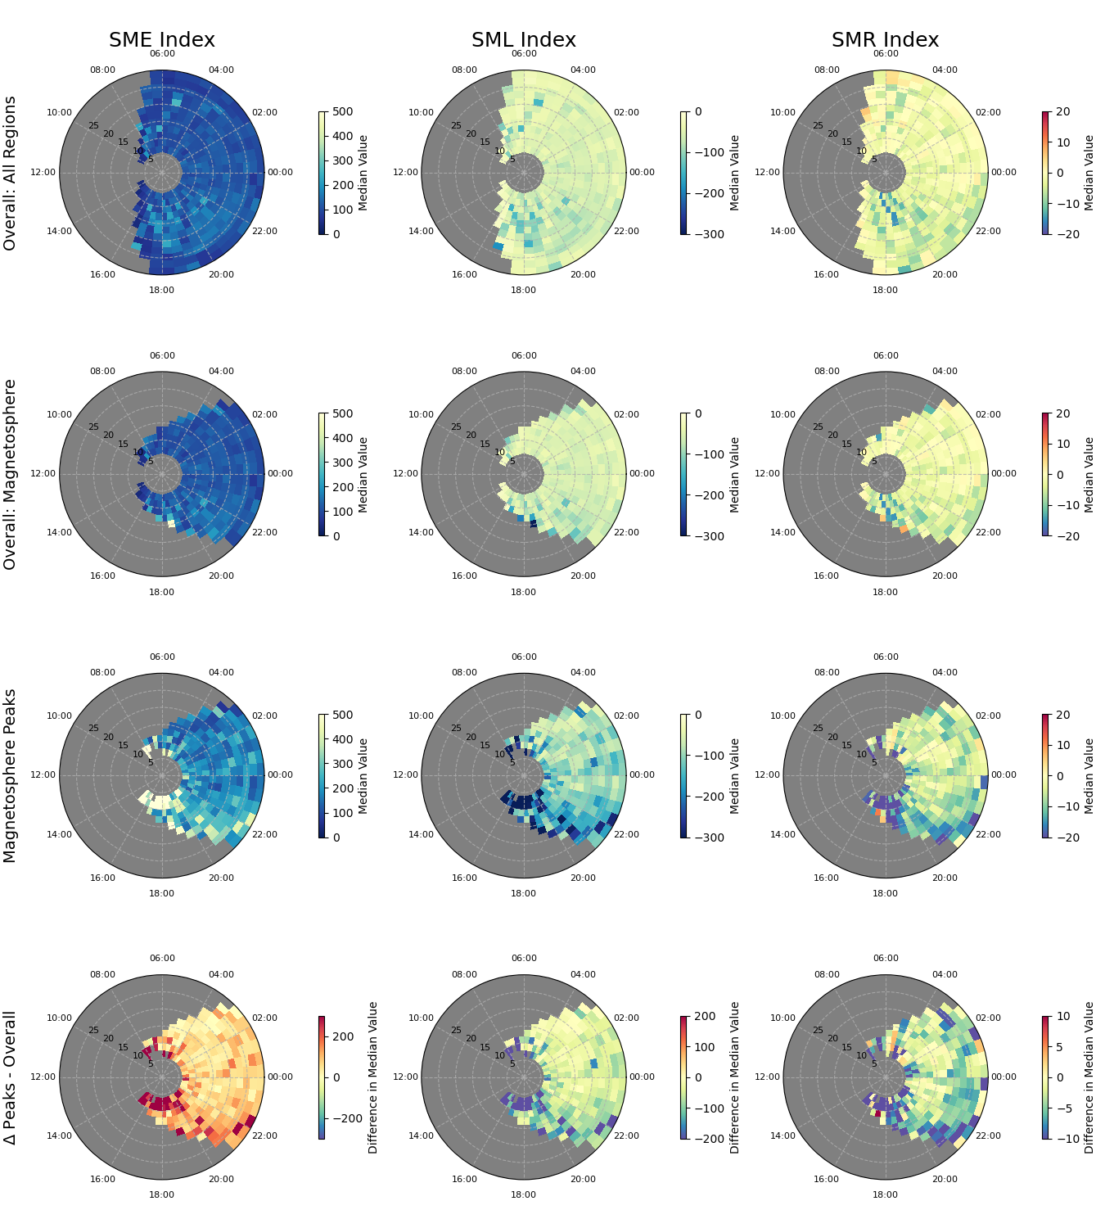
Spatial Deviations in Index Data
Differences between the spatial patterns in the bulk magnetosphere and peak occurrences illustrate heterogeneity
All global indices allude to a dawn-dusk asymmetry in the injection events
Universal increase in SME and most significantly at the dusk flank of the magnetopause
Similar pattern of exaggerated decrease observed at the dusk flank for SML and SMR

Slide 15
Conclusions
New algorithm (non-ML) approach provides simple, explainable detection of electron injection events
Used domain knowledge to tune the algorithm using the most informative features → band of electrons between 80 – 150 keV
Only interested in capturing the onset of the event
Combing through the MMS tail seasons over 5 years has resulted in a plethora of events to statistically explore
Much larger number of events in comparison to previous studies enable greater spatial and temporal resolution of event occurrence as well as co-contributing factors
Dawn/dusk asymmetries apparent in local plasma conditions as well as potentially driving factors
Events concentrated along the statistical MP range could indicate potentially new phenomena
Ongoing studies are using unsupervised clustering to explore variations in the features for each of the events
Can unsupervised clustering differentiate between different known drivers of electron enhancement in the magnetotail (e.g. dipolarization injections vs. plasma sheet flapping)
Are there populations of events that look similar in feature-space, driven by similar physics?
Do similar/different populations of events occur in distinct regions of the magnetotail?
Do similar/different populations coincide with particular solar wind, magnetospheric, and/or local plasma conditions?

Slide 17
Peak Distribution – Labeled vs. Detected

